Slide 1

Car Sale Price Prediction

Slide 2

INTRODUCTION
Predicting the price of a used cars has been studied extensively in various researches.
Car price prediction is a somehow an interesting and popular problem.
Accurate car price prediction involves expert knowledge, because price usually depends on many distinctive features and factors.
Typically, the most signiﬁcant ones are present price , brand and model, power, year, region. The fuel type used in the car as well as fuel consumption per mile highly affect the price of a car due to a frequent changes in the price of a fuel.

Slide 3

BACKGROUND STUDY
Wu et al. conducted a car price prediction study, by using a neuro-fuzzy knowledge-based system. Their prediction model produced similar results as the simple regression model.
Listian discussed, in her paper, that a regression model that was built using Support Vector Machines (SVM) can predict the price of a car that has been leased with better precision than multivariate regression.
Another approach was given by Richardson in his thesis work . Richardson applied multiple regression analysis and demonstrated that hybrid cars retain their value for a longer time than traditional cars.
Pudaruth applied various machine learning algorithms, namely: k-nearest neighbors, multiple linear regression analysis, decision trees and naïve bayes for car price prediction in Mauritius.
Noor and Jan built a model for car price prediction by using multiple linear regression.

Slide 4

PROBLEM STATEMENT
A model to predict the price of a car should be developed in order to assess its value based on a variety of characteristics. Several factors affect the price of a used car, such as company, model, year, odometer, driven, fuel type, seller type, and owner type. As a result, it is crucial to know the car's actual market value before purchasing or selling it.

Slide 5

CHALLENGES
Finding the best regression algorithm, among Linear Regression, Lasso Regression, Random Forest Regression, Ridge regression, etc., for our problem was a challenge.
Reconstructing the given dataset. Changing the categorical values into numerical form. And removing the unnecessary features.
We had a challenge in choosing dominant features for which we used heat maps using pearson coefﬁcient correlation and extra tree regressor and found the feature importance’s

Slide 6

SOLUTION APPROACH
Step 1: " saleprice_dataset.csv" dataset was used for this project and was reconﬁgured to reﬂect the important features. Data frames in which we loaded the dataset now include the ‘Advertised_Date’, ‘Sold_Date’, ‘Sale_Price’, ‘Odometer’, ‘Power’, ‘Fuel_Urban’, ‘Make_Code’, ‘Family_Code’, ‘Year_Group’, ‘Region_Description’, and ‘Vehicle_Code’
Step 2: Categorical features were then converted to numerical values. We remove multiple columns of the dataset using the get_dummies function as some columns contain the same information.
Step 3: Data Cleaning (Identifying Null Values, Filling-In Missing Values & Removing Outliers) Using pandas, NumPy, & seaborn. data visualization created on each features and discussed.
Step 4: Data Preprocessing (Standardization or Normalization) & Splitting.

Slide 7

SOLUTION APPROACH
Step 5: Transform Categorical Column Values into Integer Values and scale the dataset.
Step 6: The data has been split into training data (90%) and test data (10%).
Step 7: Function for evaluation of model created based on the MSE, RMSE and R2 Score
Step 8: Training & Testing the Data Using 8 Algorithm Models Obtained from scikit- learn, yellowbrick, & XGBoost ML Libraries in python

Slide 8



SOLUTION APPROACH
Step 9: Comparison - Machine Learning Model Performance discussed.
Step 10: best model choose based on the highest accuracy rate.
Step 11: The ﬁle is put in a pickle ﬁle. Also the performances of the model are computed.

Slide 9

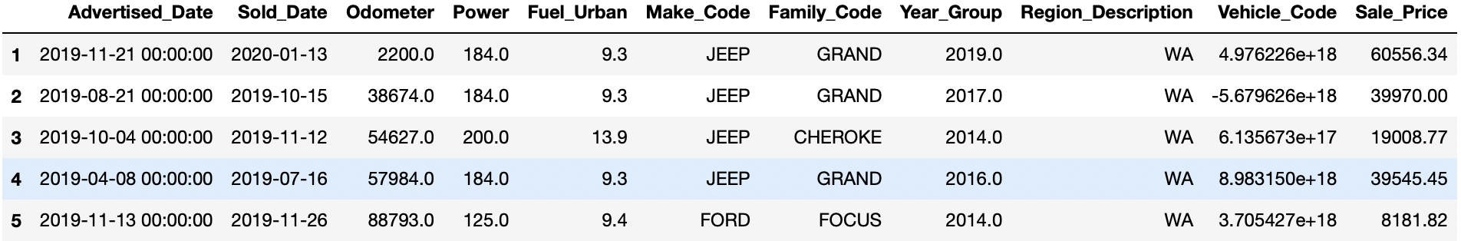
DATASET
The data we have used in this project was internal data. The dataset consists of 120k rows and 11 columns with null values. Column data consist of independent Features. The independent features contain both categorical and numeric values.

Slide 10

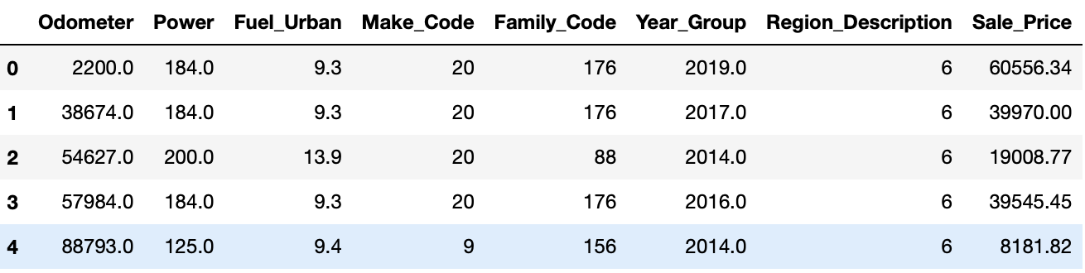
DATASET MANIPULATION
From the original dataset we searched for null values using “isnull()”. The missing values are handled with MSE with Different Imputation Methods(MSE smaller value is better for best Imputation methods)
We dropped the “Advertised_Date”,”Sold_Date” and “Vechcile code” column.
Each features outlies values are handled.
We dropped the “Advertised_Date”,”Sold_Date” and “Vechcile code” column.
As the dataset has numerical values and categorical values , We remove multiple columns of the dataset using the get_dummies function as some columns contain the same information

Slide 11
FINAL DATASET
Dataset size before pre-processing = (122595, 12)
Dataset size after pre-processing = (101812, 11)
Total 20783 rows and 3 cols removed

Slide 12
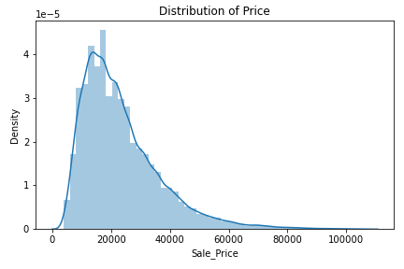
Model evaluation
Since this study concerns price predictions, it's important to consider how price distributions in regression models are skewed right, as shown in the distplot diagram of the actual data set below. For any fixed value of X (independent / predictor variable), the Y value (price / dependent / target variable) prediction will be inaccurately higher than it actually is and should be corrected for. To solve this problem, a log transformation is used to scale the price, thereby helping to generate more accurate predictions of the actual target values. For this reason, evaluations of ML model accuracies are calculated based on Root Mean Squared Log Error (RMSLE) & the Coefficient of Determination (R2).

Slide 13
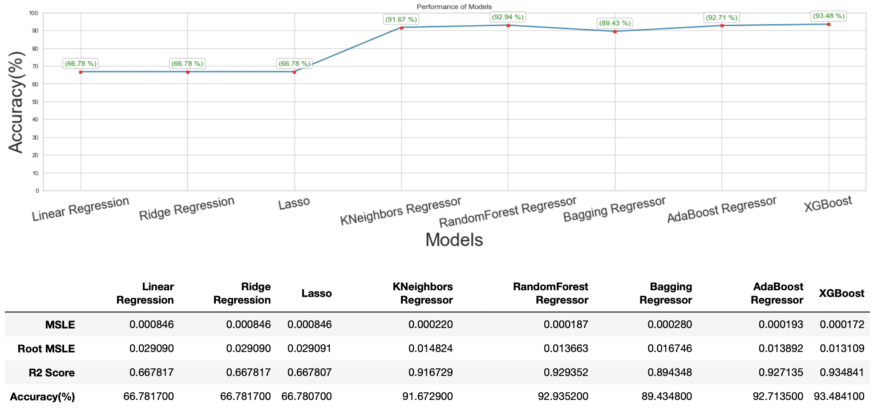
Comparison - Machine Learning Model Performance

Slide 14

Comparison - Machine Learning Model Performance
Of the eight different ML models we explored, five produced prediction accuracies of 90% which is a substantial result. These algorithms were Linear Regression, Ridge, Lasso, KNN, Random Forest Regressor, Bagging Regressor, Adaboost Regressor, and XGBoost Regressor .By performing different models, we were able to learn more about the data set and the relative importance of the variables.
As each ML algorithm was applied, information regarding the four statistical measures observed in the table above was gathered in order to assess the suitability of the ML model in meeting our studies objective of accurately predicting car prices.The first three models were based in linear regression and were all found to be unsuitable for our prediction needs based on their poor MSLE, Root MSLE and R2 scores.

Slide 15

Model selection - XGBoost ensemble model
The most suited algorithm was found to be the XGBoost ensemble-based ML model.
The advantage of the XGBoost model is its scalable and accurate implementation of gradient boosting techniques and several advanced features for model tuning, computing environments and algorithm enhancement. XGBoost can perform the three main forms of gradient boosting (Gradient Boosting (GB), Stochastic GB and Regularized GB) and is robust enough to support fine tuning and addition of regularization parameters. The 93.48% accuracy model established here provides a jumping off point for further/future exploration.

Slide 16
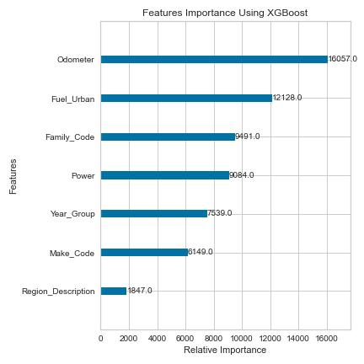
Model selection - XGBoost ensemble model
The relative importance of the features/variables generated by these early models provided useful insights however, since they indicated that several factors were influencing car price.
As we performed more learning models on the data, a few tendencies became apparent in that relative importance of features were always found to be most for both “'odometer’, “Fuel_urben” and then a handful of others.

Slide 17
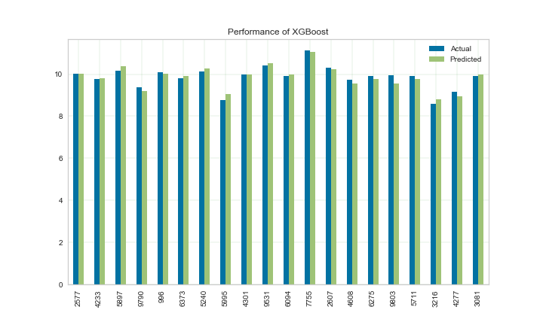
Model selection - XGBoost ensemble model
This graph shows that the error is not much. So the predicted value might actually be accurate.

Slide 18

CONCLUSION
The process applied here provides great potential in becoming an actual price prediction application that can be used by the public. Although the complex manner in which the different features impact car pricing is constantly in flux, certain areas of importance were uncovered through exploration with eight distinct ML models.
A 93.48% accuracy rating is substantial theoretically, though differences between actual versus predicted prices due to error with this model could amount to hundreds or even thousands of dollars.
For buyers in the market, that would defeat the purpose of the prediction model. Ideally, a near 100% accuracy rating should be sought after to achieve a true "working" model.

Slide 19




THANK YOU!
“Predicting the future isn’t magic It’s Artiﬁcial Intelligence.”
~Dave Waters
CREDITS: This presentation template was created by Slidesgo, including icons by Flaticon, and infographics & images by Freepik and illustrations by Stories

